Slide 1


Capstone Project Final Presentation
REGIME DETECTION FOR PORTFOLIO OPTIMIZATION
Sponsor: Mr. Blaz Zlicar (Deutsche Bank)
Advisor: Prof. Sasha Stoikov (Cornell Financial Engineering Manhattan)
Team: Enming Zhang, Haobing Meng, Huimin Wang, Joel Dsouza, Niharika Dalsania, Yiran Hao, Yuanping Du

Slide 2
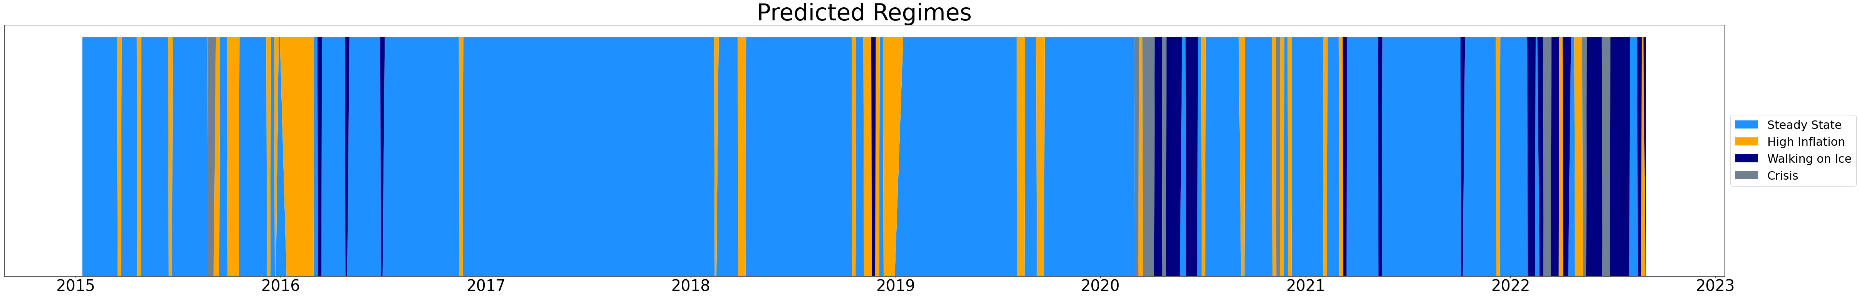
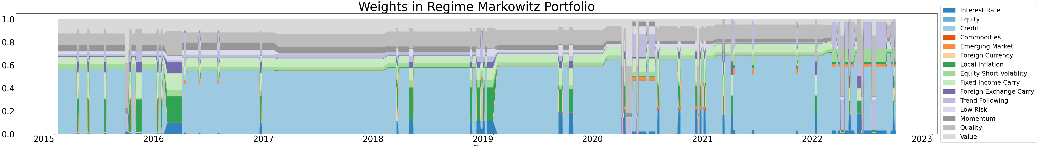
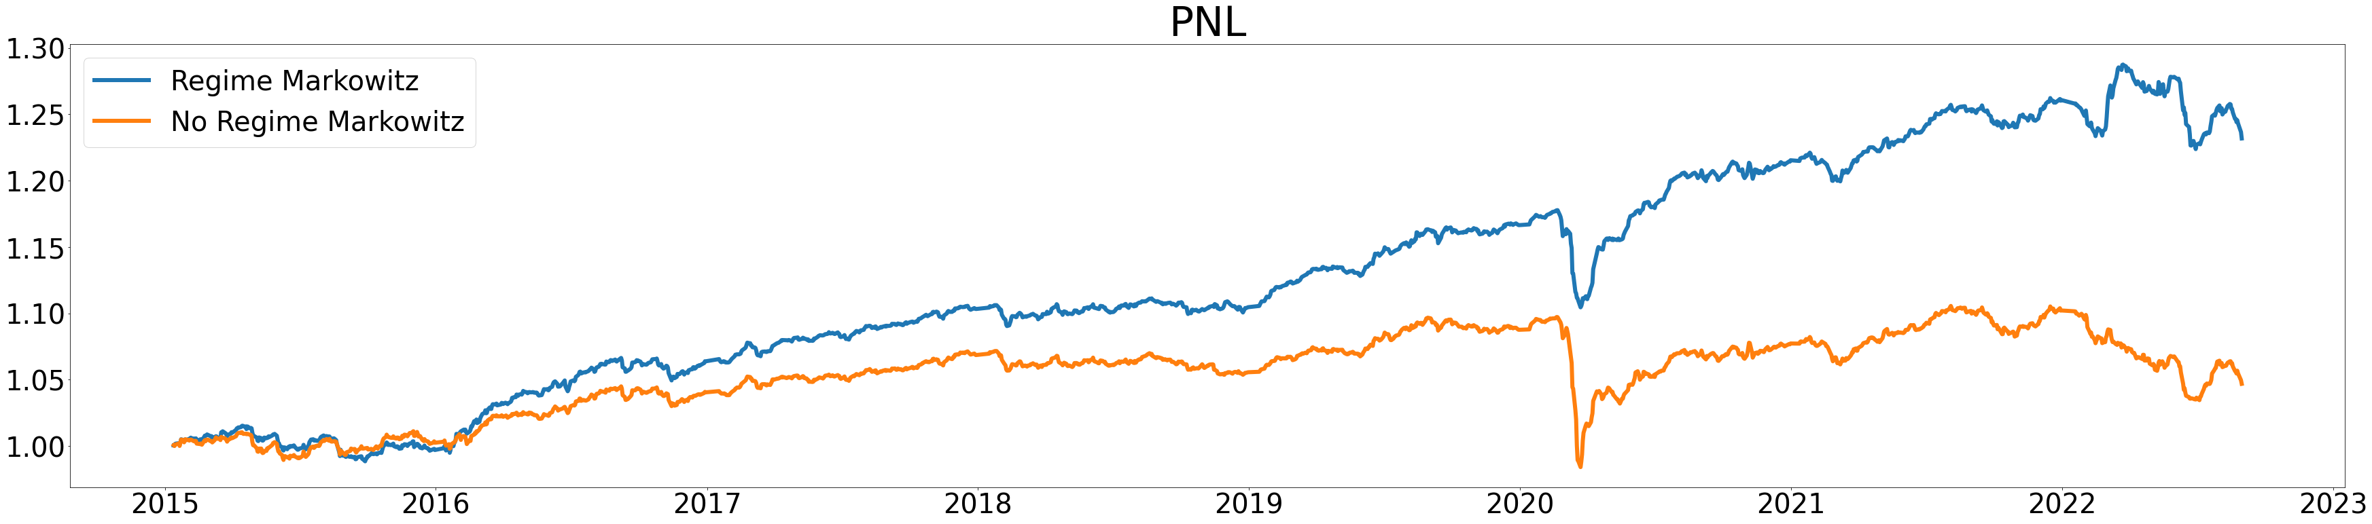
Regime Detection can boost Performance!
Model | Annualized Return (%) | Sharpe Ratio | Maximum Drawdown (%) | Calmar Ratio
No Regime Markowitz | 0.63 | 0.27 | 10.30 | 0.06
Regime Markowitz | 2.92 | 1.21 | 6.21 | 0.47
Deutsche Bank
Cornell Financial Engineering Manhattan

Slide 3




Background
Methodology
Agenda
Results Summary
Appendix

Slide 4
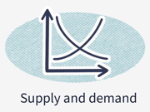

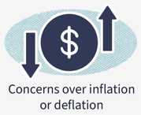
Regimes: What? Why? How?
Its more than just Bull and Bear markets
Any clusters of persistent market conditions
Bull
Bear
Static
High Volatility
Crisis
Inflation
and so on…..
Identify clusters in a scientifically robust manner
Improve portfolio asset allocation by identifying what assets do well in all what market conditions
Boost portfolio returns by macroeconomics-driven investment decision and tail risk management
Deutsche Bank
Cornell Financial Engineering Manhattan

Slide 5
What’s New?
Previous approaches:
Supervised Models: require labor intensive labeling for training data regimes
Unsupervised Models: challenging to map the identified cluster to real-world regimes
Two Sigma’s research - Unsupervised GMM for in-sample regime detection
Our research
Out of sample regime detection
Regime wise optimal portfolios construction
Run and evaluate trading strategies
Fine-tuning details to boost performance
Deutsche Bank
Cornell Financial Engineering Manhattan

Slide 6
All about Data
Core Macro | Secondary Macro | Macro Styles | Equity Styles
Interest Rate | Foreign Currency | Fixed Income Carry | Low Risk
Equity | Emerging Market | Foreign Exchange Carry | Momentum
Credit | Equity Long Short | Trend Following | Quality
Commodity | Local Inflation | - | Value
Source - Bloomberg and DB Proprietary Indices
Frequency and Duration - Daily data from Jan 2002 to Aug 2022
Preprocessing - Forward fill missing data and take log returns
Principal Component Analysis
First 12 principal components explain about 95% variance
Factors are uncorrelated
Deutsche Bank
Cornell Financial Engineering Manhattan

Slide 7
Background
Methodology
Agenda
Results Summary
Appendix

Slide 8
Flow Chart
Mean and variances of smooth regimes
Train data
Train the GMM
Detected regimes
Smooth regimes in train data
Portfolio Construction and Analysis
Trained
parameters
Optimal Markowitz
weights in each regime
Test data
Detect regimes using trained GMM
Detected regimes
Smooth regimes in test data
Performance Evaluation
Deutsche Bank
Cornell Financial Engineering Manhattan

Slide 9
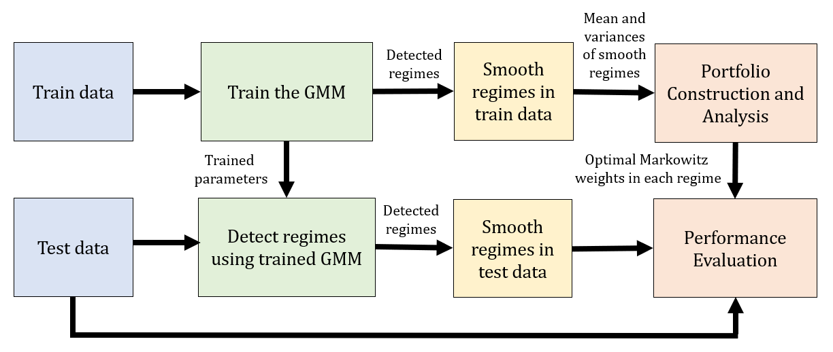

Training the Gaussian Mixture Model
Train data
Regime detection
factor data
Numbers of regimes
Random initialisations
Number of iterations
Train the GMM
Hyperparameter Tuning
Model
Sensitivity Analysis
$$\left[\begin{matrix}\begin{aligned}μ_{1} \\ μ_{2}\end{aligned} & \begin{aligned}Σ_{1} \\ Σ_{2}\end{aligned} \\ μ_{3} & Σ_{3} \\ μ_{4} & Σ_{4}\end{matrix}\right]$$
Probabilities of being in a certain regime (p1, p2, p3, p4)
Detected regime has probability
max(p1, p2, p3, p4)
Deutsche Bank
Cornell Financial Engineering Manhattan

Slide 10
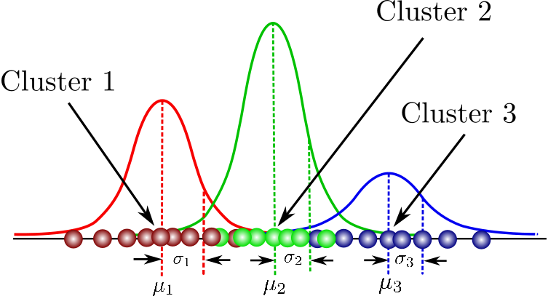
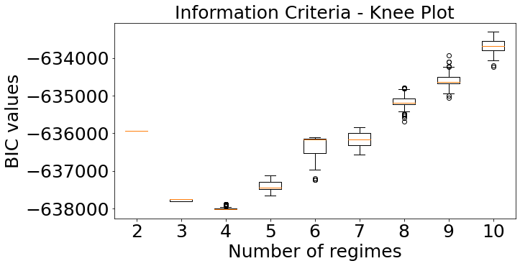
Model Introduction
Gaussian Mixture model - unsupervised model parameterized by
Component means and covariances
Estimates of component probabilities given the data
Estimate parameters using Expectation-Maximisation algorithm
Sensitivity Analysis - Run model with 100 different random initialization
Hyperparameter Tuning for number of clusters
Chose optimal as the one with least BIC score (not based on PnL because it will increase with granular regimes)
Optimal number of regime = 4 for any initialization
Idea 1: Change optimal number of regimes dynamically
Deutsche Bank
Cornell Financial Engineering Manhattan

Slide 11
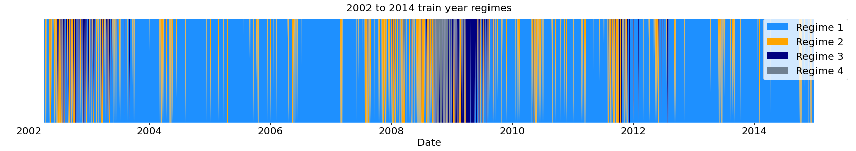
In-sample Regimes
GMM gives probabilities of being in either of the 4 regimes and picks the one with highest probability
Issues with detected regimes
Short-lived regimes - does not match our economic sense
Needs frequent rebalancing - high transaction costs
Solution: Smooth the detected regimes
Idea 2: Use weekly data for regime detection
Deutsche Bank
Cornell Financial Engineering Manhattan

Slide 12

Portfolio Construction on Smooth Regimes
Smooth regimes in train data
Probability Threshold
Probability Exponential
Weighted Average
Regime Maximum
Count
Portfolio Construction and Analysis
Markowitz Portfolios
Top Sharpe Portfolios
Weights for portfolio in each regime (understand if it makes intuitive sense in real world)
$$\left[\begin{matrix}\begin{aligned}μ_{1} \\ μ_{2}\end{aligned} & \begin{aligned}Σ_{1} \\ Σ_{2}\end{aligned} \\ μ_{3} & Σ_{3} \\ μ_{4} & Σ_{4}\end{matrix}\right]$$
on smooth regimes
Use these parameters to map detected regimes to real world regimes
Deutsche Bank
Cornell Financial Engineering Manhattan

Slide 13
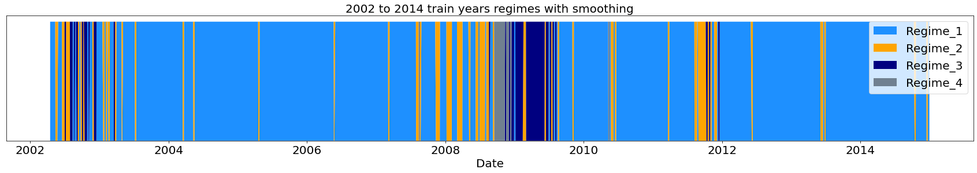
Regime Smoothing
Probability Threshold - identify regime only when maximum probability regime exceeds threshold
Probability Average - choose regime with maximum exponential weighted average probability
Rolling Window Majority - choose regime as the majority regime in past 5 days (1 trading week)
Deutsche Bank
Cornell Financial Engineering Manhattan
Notes:
TODO! – Explain all smoothing methods
TODO! – explain why choose max count (prob threshold – threshold is extra param, exp weighted avg. smoothing factor alpha is extra param – adds complexity, avoid that by simple max count over past 5 days to stick to weekly rebalancing which is practical too)
TODO! Plot smooth regimes on same time frame as before and highlight same region to show difference

Slide 14
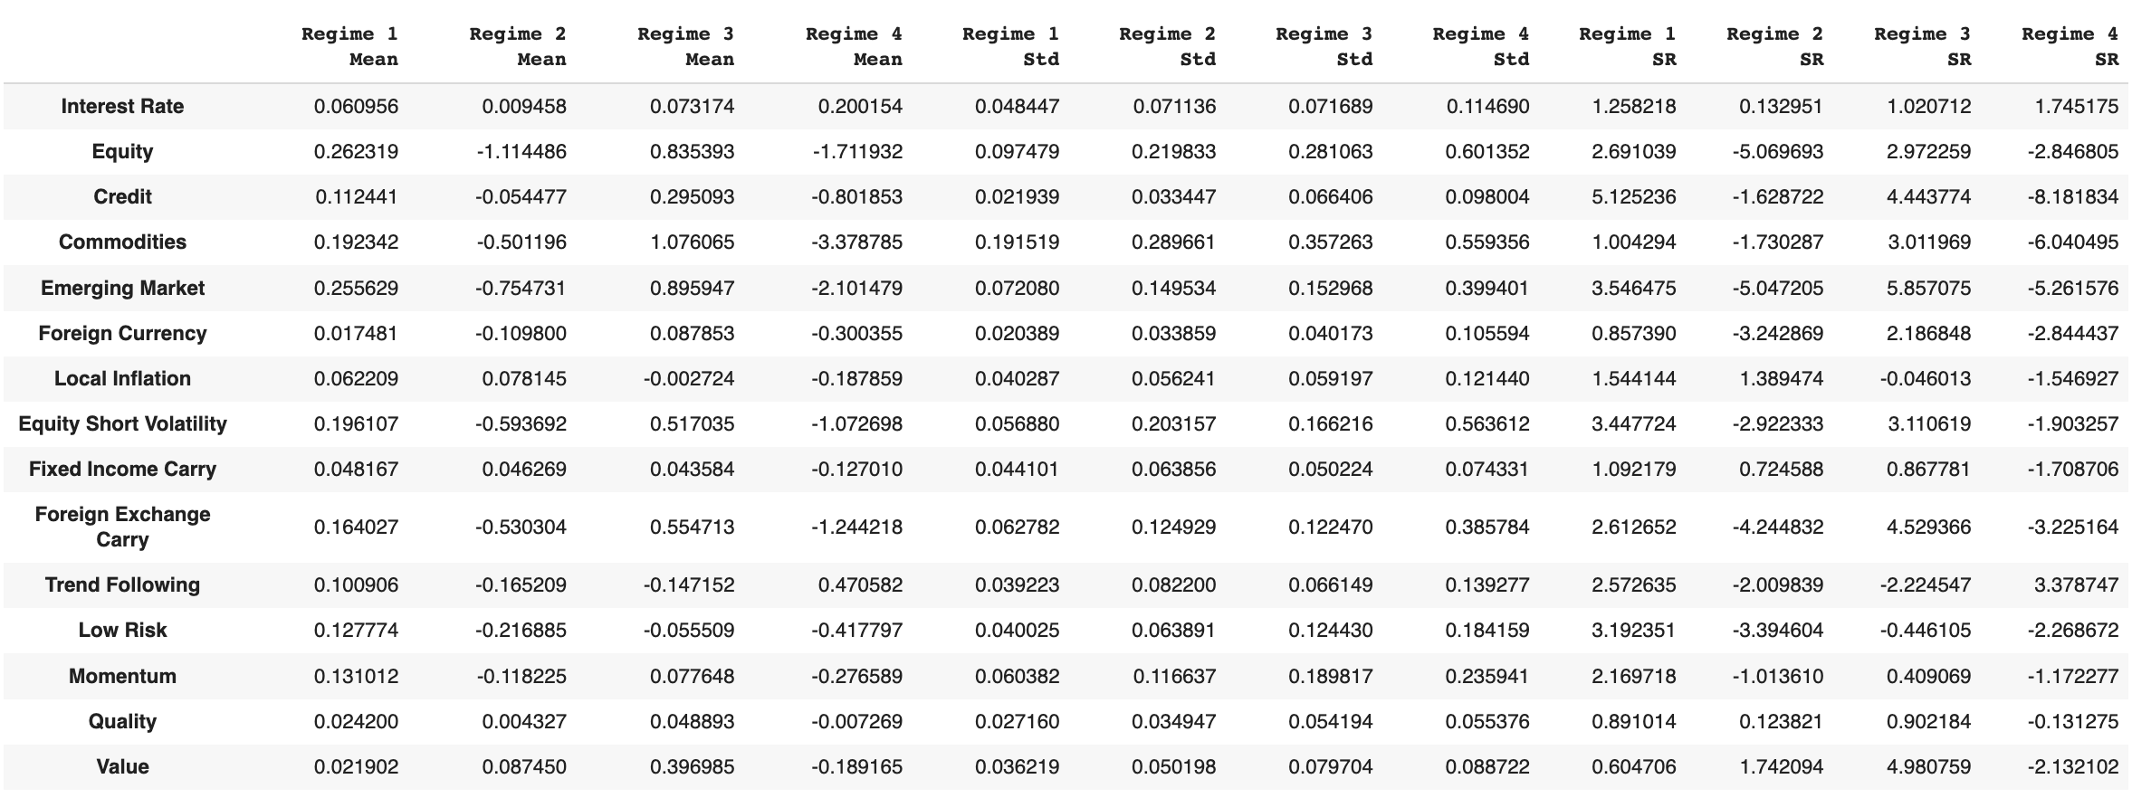
Regime Interpretation
Regime 1 | Regime 2 | Regime 3 | Regime 4
Steady State | High Inflation | Walking on Ice | Crisis
Almost all positive returns | Most factors are negative, except FI, inflation and value | High returns | Almost all negative returns
Low volatility for almost all | High volatility in commodity | High volatility | High volatility for almost all
Calculation Based on Training set from 2002 to 2014
Deutsche Bank
Cornell Financial Engineering Manhattan
Notes:
TODO! - Look at mean and variance in all regimes after smoothing and map to real world regimes, Highlight means and variance that help make the decision.

Slide 15
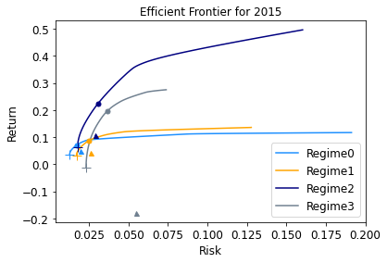
Markowitz Portfolios
Markowitz with different risk aversion parameters - choose portfolio with maximum Sharpe Ratio
Inverse volatility portfolio always inside the curve
Minimum variance portfolio at the left end of the curve
Idea 3: Weigh portfolios using probabilities to avoid changing portfolios drastically when regimes change
Circle: Max Sharpe
Triangle: Inverse Vol
Plus: Min Variance
 | Interest Rate | Equity | Credit | Commo-dities | Emerging Market | Foreign Currency | Local Inflation | Equity Short Vol. | Fixed Income Carry | Foreign Exchange Carry | Trend Follow | Low Risk | Momentum | Quality | Value
Steady state | 0 | 0 | 0.4862 | 0.0041 | 0.0173 | 0 | 0 | 0.1217 | 0.0506 | 0.0387 | 0.0363 | 0.0597 | 0.0506 | 0.0580 | 0.0763
High Inflation | 0 | 0 | 0 | 0 | 0 | 0 | 0.3768 | 0 | 0.0910 | 0 | 0 | 0 | 0 | 0 | 0.5321
Walking on Ice | 0 | 0 | 0.1628 | 0 | 0.1321 | 0 | 0 | 0.0372 | 0.3205 | 0.0540 | 0.0425 | 0.0588 | 0 | 0.0945 | 0.0973
Crisis | 0.4328 | 0 | 0 | 0 | 0 | 0 | 0 | 0 | 0 | 0 | 0.5671 | 0 | 0 | 0 | 0
Markowitz portfolio weights on train set of 2002-2014
Deutsche Bank
Cornell Financial Engineering Manhattan
Notes:
In

Slide 16
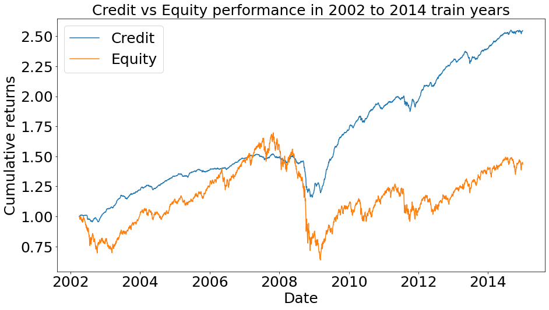
Is Equity weight a concern?
Technically, Equity does get non-zero weights, but through the Equity Style factors
However, credit gets weights over Equity - can be intuitively explained as follows :
Intuition from Model: Markowitz focus on risk adjusted returns, which is better for Credit than Equity
Intuition from Economics: Most of our training period includes post 2008 financial crisis period in which credit was an attractive investment because of the Fed credit easing policies
Idea 4: Give minimum weights to all assets, especially to equities
Factor | Ret. (%) | Vol. (%) | Sharpe Ratio
Credit | 7.45 | 3.45 | 2.19
Equity | 2.80 | 17.53 | 0.25
Deutsche Bank
Cornell Financial Engineering Manhattan
Notes:
In

Slide 17
Top Sharpe Portfolios
Focus on the best factors to long
Take respective highest Sharpe ratio factors in all regimes
 | Steady State | High Inflation | Walking on Ice | Crisis
Highest Sharpe Ratio | Credit | Value | Emerging Market | Trend Following
Second Highest Sharpe Ratio | Emerging Market | Local Inflation | Value | Interest Rate
Max Sharpe portfolios on train set of 2002-2014
Deutsche Bank
Cornell Financial Engineering Manhattan

Slide 18
Out of Sample Regime Detection
Test data
Investable factor data
Detect regimes using trained GMM
Trained model
Probabilities of being in a certain regime (p1, p2, p3, p4)
Detected regime has probability
max(p1, p2, p3, p4)
Deutsche Bank
Cornell Financial Engineering Manhattan

Slide 19
Rolling-window Testing
Test period: 2015 to 2022
Using rolling window training years, recalibrate model for every test year with past 13 years of data
Detect and smooth regimes and use regime-wise portfolios built earlier to calculate PNL of different strategies
Idea 5: Use expanding window training years, staring from 2002
2002｜2003｜ ··· ｜2013｜2014｜2015｜2016｜
Training years
Test year
2002｜2003｜ ··· ｜2013｜2014｜2015｜2016｜
Training years
Test year
Deutsche Bank
Cornell Financial Engineering Manhattan

Slide 20
Performance Evaluation
Smooth regimes in test data
Regime Maximum
Count
Performance Evaluation
Out-of-sample performance
PNL
Sharpe Ratio
Maximum Drawdown
Calmar Ratio
Final smooth regimes for weekly rebalanced portfolio
Deutsche Bank
Cornell Financial Engineering Manhattan

Slide 21
Background
Methodology
Agenda
Results Summary
Appendix

Slide 22
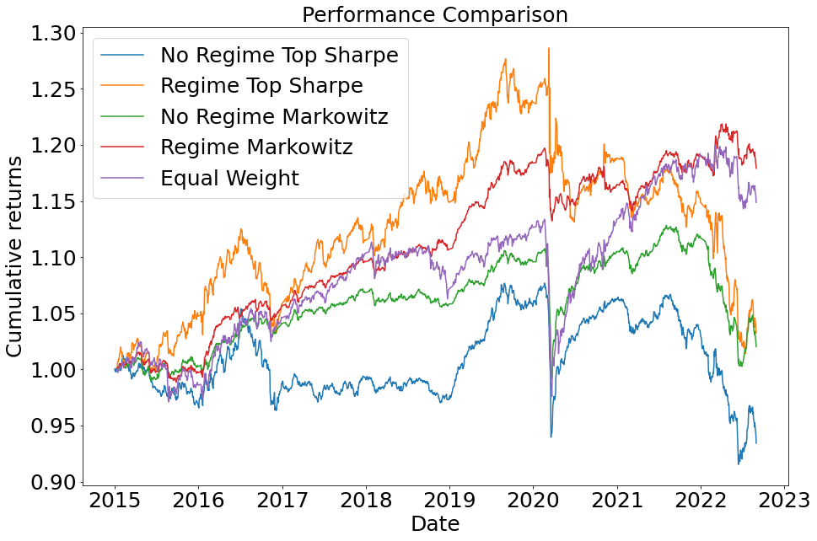
Model Comparison
Model | Annualized Return (%) | Sharpe Ratio | Maximum Drawdown (%) | Calmar Ratio
No Regime Top Sharpe | -0.91 | -0.21 | 15.00 | -0.05
4 Regime Top Sharpe | 0.41 | 0.10 | 21.17 | 0.03
No Regime Markowitz | 0.27 | 0.12 | 11.13 | 0.03
4 Regime Markowitz | 2.30 | 0.95 | 5.42 | 0.43
Equal Weight | 1.94 | 0.46 | 13.94 | 0.14
Deutsche Bank
Cornell Financial Engineering Manhattan

Slide 23
Additional Experiments for Regime Markowitz
Model | Description | Annualized Return (%) | Sharpe Ratio | Maximum Drawdown (%) | Calmar Ratio
Original model | As discussed so far | 2.30 | 0.95 | 5.42 | 0.43
Change number of regime dynamically | Change the number of regimes in each rolling window based on training data BIC | 2.27 | 0.99 | 5.30 | 0.43
Use weekly data for regime detection | Use weekly average data for regime detection without smoothing | 0.29 | 0.13 | 8.22 | 0.04
Weigh portfolios using probability | Use a combination of portfolios for each regime, weighted by probability of each regime yield by the GMM model | 1.61 | 0.76 | 4.49 | 0.36
Use expanding window for training | Training dataset will grow as time goes | 2.92 | 1.21 | 6.21 | 0.47
Minimum weight to equities | Modifying the Markowitz to ensure minimal weights for any assets (here, at least 20% on equity) | 3.23 | 0.76 | 10.55 | 0.31
Changing investable factors | Change the investable universe to 7 US assets | 5.35 | 1.30 | 9.9 | 0.53
Deutsche Bank
Cornell Financial Engineering Manhattan

Slide 24
Main Takeaways
Financial markets have distinguishable clusters with specific properties
Different assets perform differently in each of these clusters
Regime detection model can capture superior performance of certain assets in each regimes, boosting the overall portfolio performance
Very flexible and generalizable model - streamlined to allow any changes as follows:
Use different model settings as discussed above
Run entire pipeline on completely new datasets
Further improvements
Use Hidden Markov Model (HMM) for Regime Detection
Use independent time frames for Regime Detection and Portfolio Construction
Use longer time frame in training years for Regime Detection to cover all regimes, giving more importance to recent years data
Build portfolios based on performance of different assets in recent years
Recalibrate the model more frequently than yearly
Deutsche Bank
Cornell Financial Engineering Manhattan

Slide 25
Background
Methodology
Agenda
Results Summary
Appendix

Slide 26
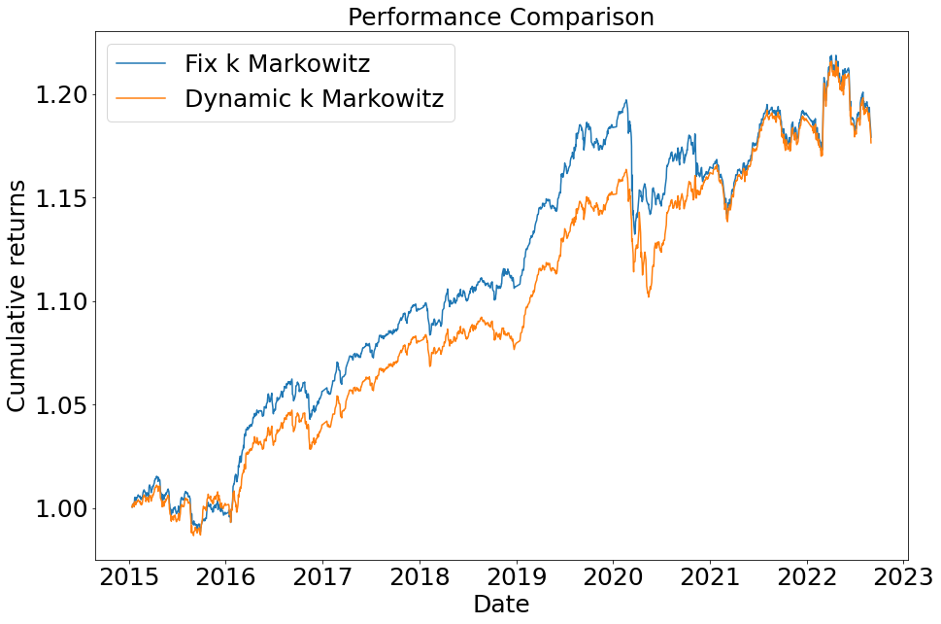
Idea 1: Changing Number on Regimes Dynamically
Model | Annualized Return (%) | Sharpe Ratio | Maximum Drawdown (%) | Calmar Ratio
Dynamic number of regimes | 2.27 | 0.99 | 5.30 | 0.43
Fix number of regimes to 4 | 2.30 | 0.95 | 5.42 | 0.43
Both gives comparable results, but for choosing optimal number of regimes dynamically note:
Choose the number of regimes based on BIC but evaluate using PnL
In-sample and out-of-sample distribution might differ
Difficult to interpret regimes at every rebalance
Deutsche Bank
Cornell Financial Engineering Manhattan

Slide 27
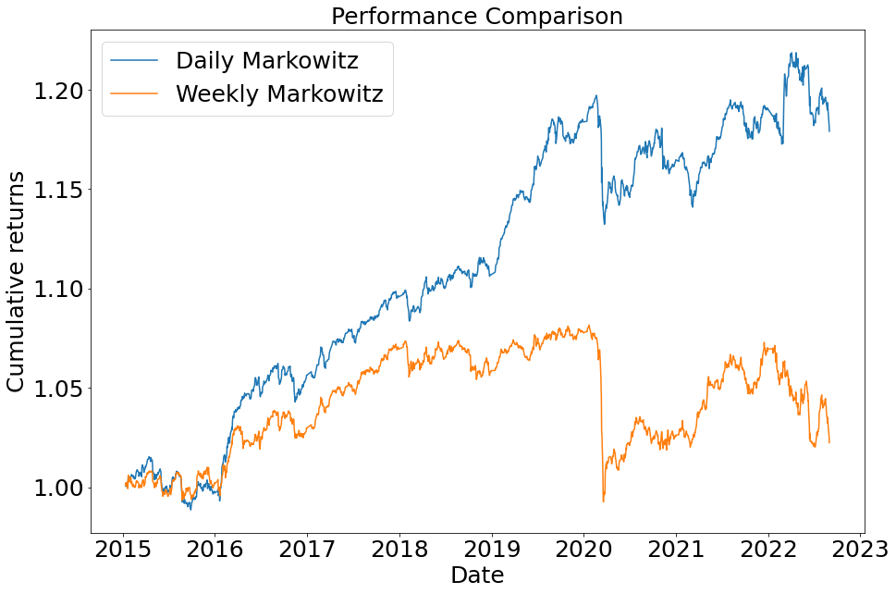
Idea 2: Weekly Data for Regime Detection
Model | Annualized Return (%) | Sharpe Ratio | Maximum Drawdown (%) | Calmar Ratio
Daily Data | 2.30 | 0.95 | 5.42 | 0.43
Weekly Data | 0.29 | 0.13 | 8.22 | 0.04
Use weekly average data for regime detection without any smoothing
Yields poorer results, possibly because the model uses less information, so regimes are not as accurate as with daily data
Deutsche Bank
Cornell Financial Engineering Manhattan

Slide 28
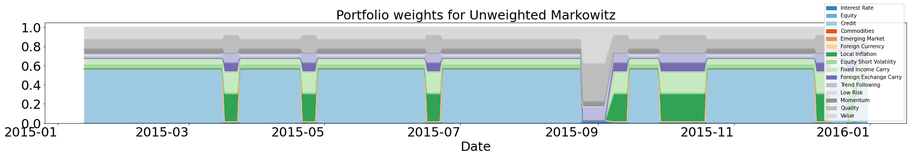
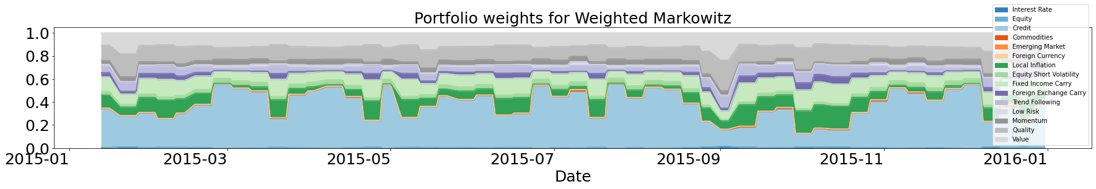
Idea 3: Weigh Portfolios using Probabilities
Instead of holding a regime-specific portfolio at that regime , hold weighted combination of portfolios from all regimes, weighted by probability of occurrence of each regime
Weighted Markowitz gives poorer results but saves rebalancing transaction costs
 | Unweighted Markowitz | Weighted Markowitz
Ann. Return (%) | 2.30 | 1.61
Sharpe Ratio | 0.95 | 0.76
Max. Draw. (%) | 5.42 | 4.49
Calmar Ratio | 0.43 | 0.36
Deutsche Bank
Cornell Financial Engineering Manhattan

Slide 29

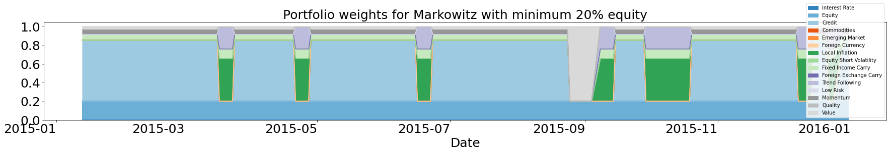
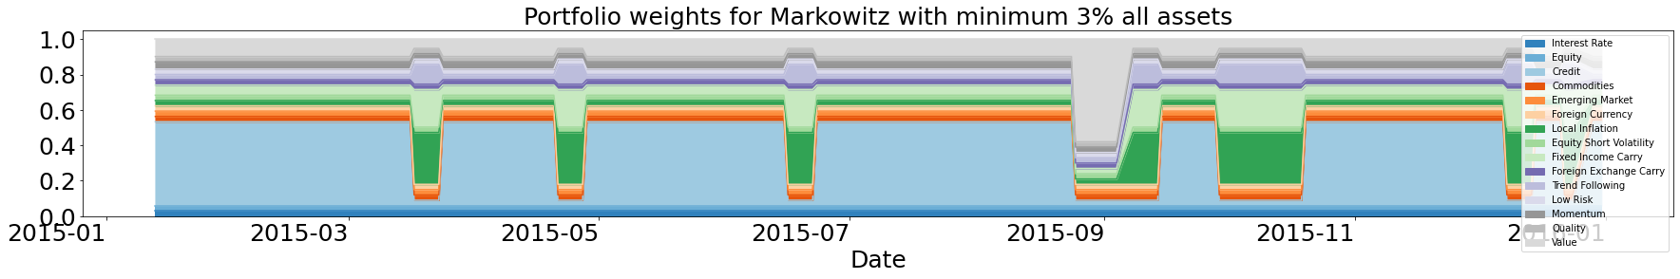
Idea 4: Minimum Weight to Equity/All Assets
Equity takes the minimum weight while credit takes lager weights
More equity weights gives higher returns, lower Sharpe, and larger drawdowns
 | No constraint | Min weight to equity | Min weight to all
Ann. Return (%) | 2.30 | 3.23 | 2.41
Sharpe Ratio | 0.95 | 0.76 | 0.80
Max Draw. (%) | 5.42 | 10.55 | 7.99
Calmar Ratio | 0.43 | 0.31 | 0.30
Deutsche Bank
Cornell Financial Engineering Manhattan

Slide 30
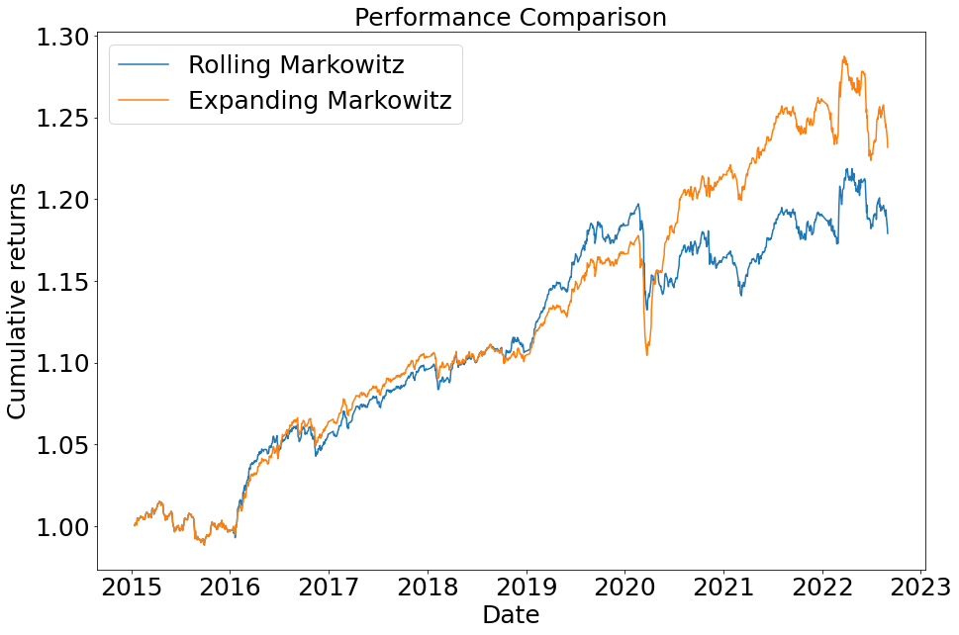
Idea 5: Expanding Window Training
Model | Annualized Return (%) | Sharpe Ratio | Maximum Drawdown (%) | Calmar Ratio
Rolling | 2.30 | 0.95 | 5.42 | 0.43
Expanding | 2.92 | 1.21 | 6.21 | 0.47
Use expanding window for training model every year i.e., use all history available
Yields better results, possibly because model now uses more information so regimes may be identified more accurately than with rolling window training
Deutsche Bank
Cornell Financial Engineering Manhattan

Slide 31
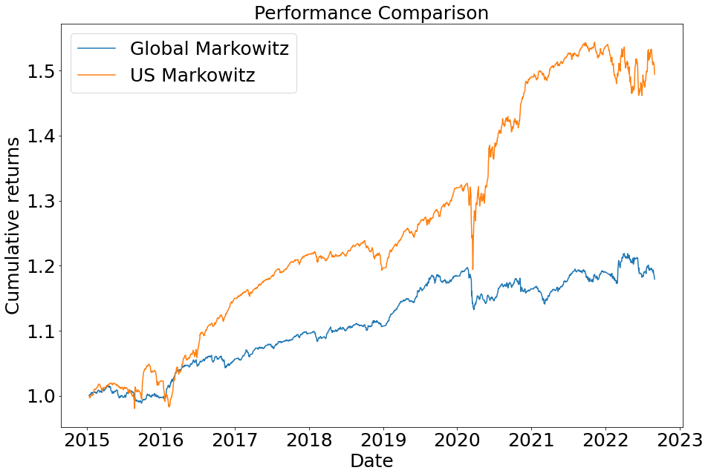
Model Generalization – US Portfolio
Model | Annualized Return (%) | Sharpe Ratio | Maximum Drawdown (%) | Calmar Ratio
Global Portfolio | 2.30 | 0.95 | 5.42 | 0.43
U.S. Portfolio | 5.35 | 1.30 | 9.9 | 0.53
Very flexible and generalizable model - streamlined to allow any changes as follows:
Tuning parameter as discussed above
Run entire pipeline on a completely new dataset
Robust results on new dataset (U.S. for example):
For U.S. investor willing to bear higher drawdown, US Portfolio yields better results in long term
Deutsche Bank
Cornell Financial Engineering Manhattan

Slide 32
QUESTIONS?

